Slide 1
Safe and Adaptable Navigation using RL and Optimal Control
Research Presentation
By: Jatin Sikka

Slide 2
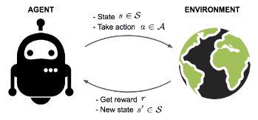
Introduction
Reinforcement Learning Using TRPO
PyBullet: physics simulation
OpenAI Gym: developing RL
Reinforcement learning visualization [3]
Notes:
PyBullet is primarily used for its physics simulation capabilities. It provides: real world physics, tools to import URDF, and an environment for the agent to interact
OpenAI Gym, on the other hand, is used as a framework for developing and comparing reinforcement learning algorithms. It provides interface, functions like step, resetting and rendering

Slide 3
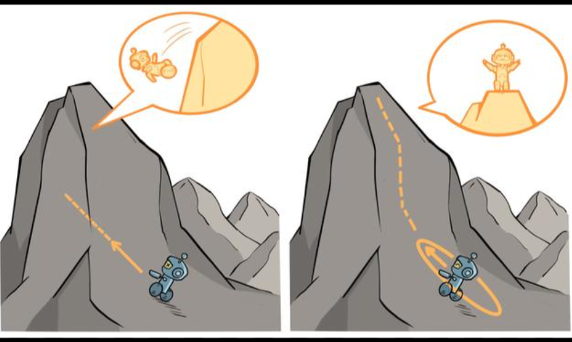
Theory
TRPO agent, leverages a neural network
policy model that interprets the simulation state
to decide on the best actions.
Find the best improvement
Check whether the approximation is good
Increase or decrease the Trust region
Repeat Steps until goal is reached
TRPO visualization [5]
Notes:
Many policy gradient approaches cannot guarantee monotonous improvement of its performance due to rapid changes in the policy updates.
On the other hand, TRPO is based on trust-region optimization that guarantees monotonous improvement by adding trust-region constraints to satisfy how close the new policy and old policy are allowed to be

Slide 4
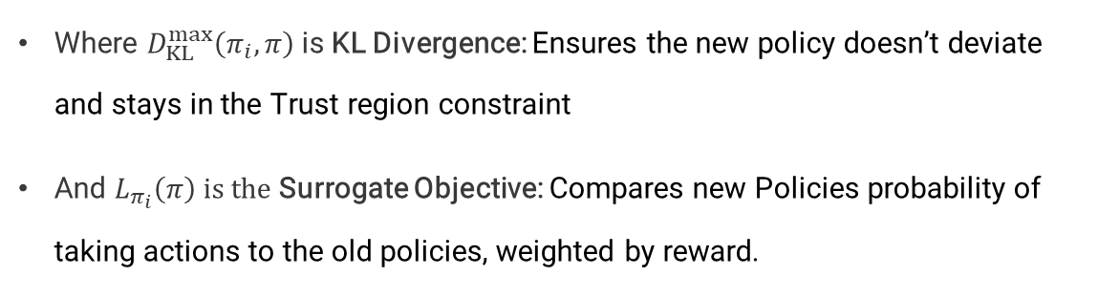
TRPO Agent
$$\text{Policy} \text{update} Π_{i+1}=\arg{\max\left[L_{π_{i}}\left(π\right)−CD_{KL}^{max}\left(π_{i},π\right)\right]}$$
Where $D_{KL}^{max}\left(π_{i},π\right)$is KL Divergence: Ensures the new policy doesn’t deviate and stays in the Trust region constraint
And $L_{π_{i}}\left(π\right) is the$Surrogate Objective: Compares new Policies probability of taking actions to the old policies, weighted by reward.

Slide 5
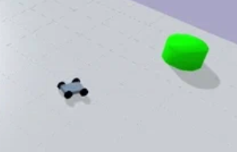
Implementation
Environment Setup:
Custom environment (car, goal, obstacles)
2-degree action (acceleration & steering)
8-degree state space (xy position of target and xy position, orientation and velocity of car)
Environment visualization [3]

Slide 6
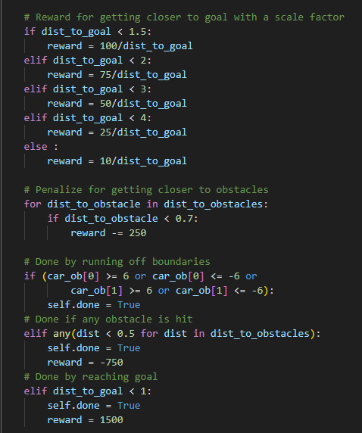
Reward Function
Positive Reinforcement (Rewarding):
Proximity to the goal
Reaching the goal
Negative Reinforcement (Penalizing):
Unsafe proximity to obstacle
Collision with an obstacle

Slide 7
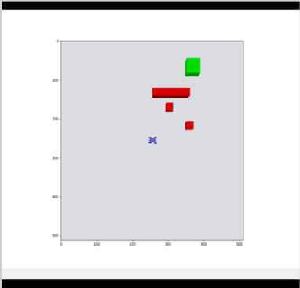
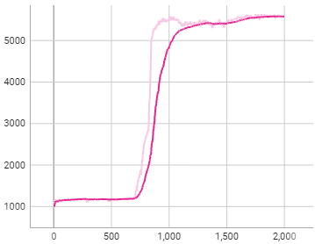
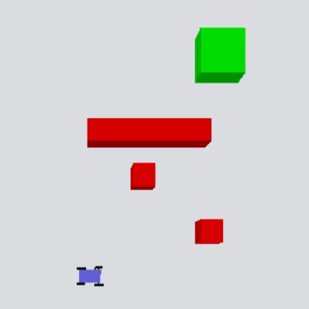
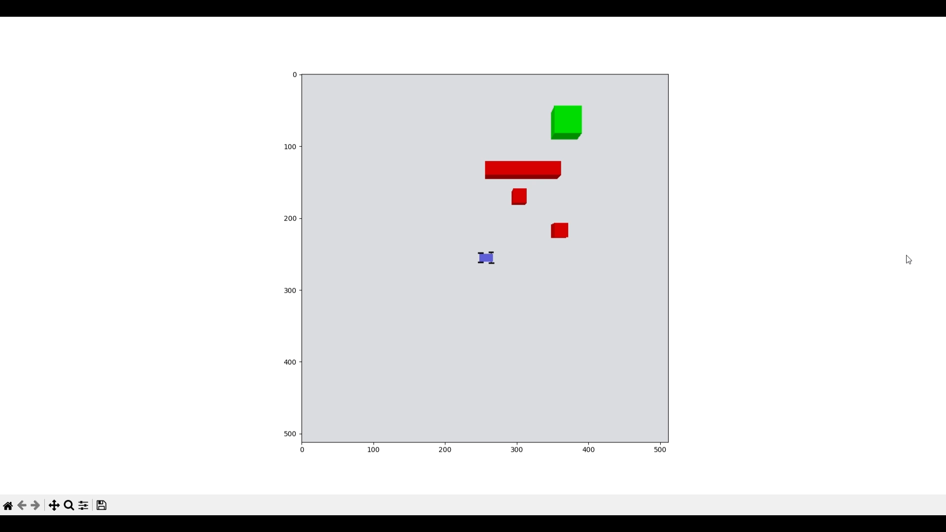
Result
Avg. Reward
Avg. Reward Smoothed
Reward
Video 1: Untrained
Video 2: Trained
Epoch
Average reward over 2000 iterations

Slide 8
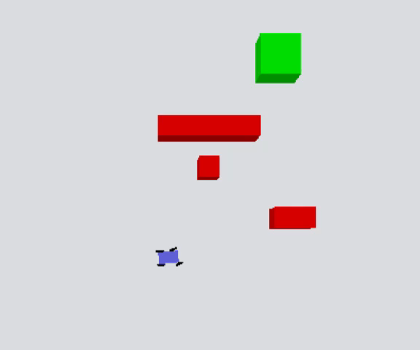
Lessons learned
Reward function fine tuning
RL disadvantages
Video 3: Reward function before tuning

Slide 9
Future Work
Increase Training Time/ Epoch
Add uncertainties to the environment
Extend Hopf formula for non-linear systems
Integrate Hopf formula as open loop control

Slide 10
References
Donggun Lee, “Safety-Guaranteed Autonomy under Uncertainty”, University of Californica, Berkeley, 2022
Schulman, J., Levine, S., Moritz, P., Jordan, M., & Abbeel, P. (2017). Trust Region Policy Optimization. arXiv preprint arXiv:1502.05477v5 [cs.LG]. University of California, Berkeley, Department of Electrical Engineering and Computer Sciences.
Maggiolino, G. (2019, October 22). Creating OpenAI Gym Environments with PyBullet (Part 1).
Weng, L. (2018, February 19). A (Long) Peek into Reinforcement Learning.
Karunakaran, D. (2020, October 12). Trust Region Policy Optimisation (TRPO) — a policy-based Reinforcement Learning. Intro to Artificial Intelligence.

